Slide 1



PORTOFOLIO
PROJECT
Judul Portofolio
by
Adin Nugroho
Data Analysis Enthusiast | Career Switcher

Slide 2


Profile
ADIN NUGROHO, S. T.
Data Analysis Enthusiast
Education
S1 Chemical Engineering – Universitas Sriwijaya
3 years experience in palm oil refining operations. Skilled in supervising production lines, leading shift teams, and improving plant efficiency and throughput. Strong in cross-functional coordination, safety, quality control, and SAP data management. Detail-oriented, adaptable, and focused on continuous improvement.

Slide 3
Experience
Production Supervisor
PT. Synergy Oil Nusantara, Batam (IFFCO Group)
& PT. Sari Dumai Sejati (Apical Group)
Responsible for Operational Plant Production, Focusing in team leadership, coordinate with cross-functional departments, support analyze problem with data

Slide 4
PORTOFOLIO
PROJECT
Complete Office Administration Set-up at PT Persona Analitika Asia
by
Adin Nugroho
Chemical Engineering Graduate | 3 years experience in plant operational | Data Analysis Enthusiast

Slide 5
Corporate Data Management & Operational Administration Portfolio
Client: A Leading National Pharmacy Retail Chain
Consultant: Talentiv Jobs (PT Persona Analitika Asia) – HR & Management Consulting
Data Cleansing
Inventory Status Automation
Data Integration & Analysis
Data Visualisation
A major pharmacy retail company in Indonesia, operating across five provinces with tens of thousands of weekly product transactions, has requested support from Talentiv Jobs (PT Persona Analitika Asia). The company is facing challenges in conducting its annual sales performance analysis and organizing its large, unstructured historical data.
The client expects the consulting team to deliver clear, actionable datasets and visualizations that enable stakeholders to make impactful data-driven decisions across HR, store performance, and inventory planning

Slide 6
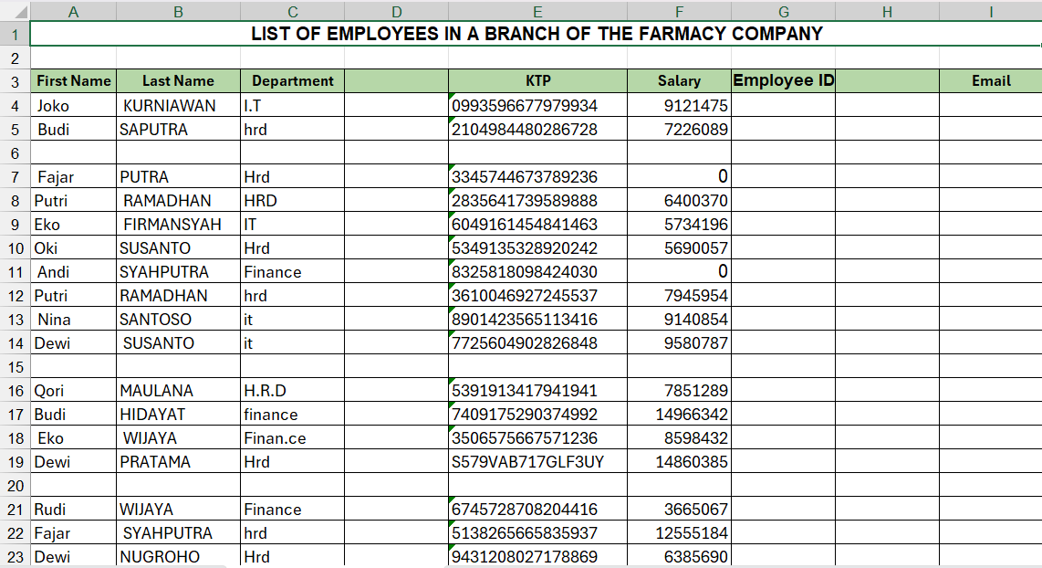
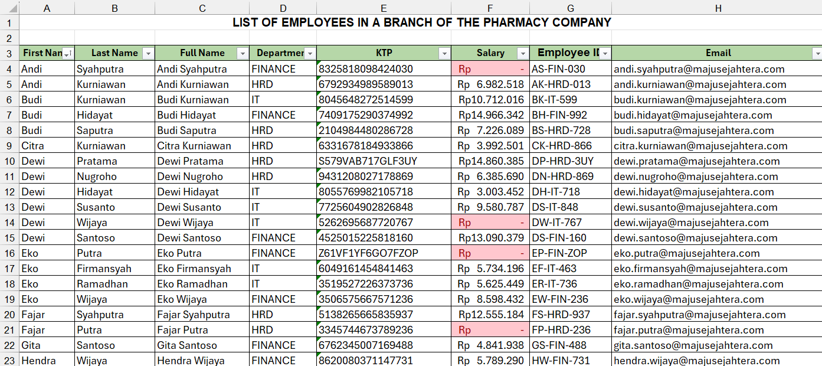
DATA CLEANSING
The steps for data cleansing is:
Delete blank row and columns
Checking if there is duplicated data
Fixing Format data values per column using filter, concatenate, replace function to get clean and formed data
Highligt the unusual data to confirm to stakeholder
Before
https://bit.ly/4qBwJef
After

Slide 7
DATA CLEANSING
Here is a clean, well-formatted, and structured the company employees data,
We generated Employee ID and E-mail, based on cleaned data from full name, department, and National ID
All the data type is the nominal category
There is unusual formed on National ID, probably employee come from overseas.

Slide 8
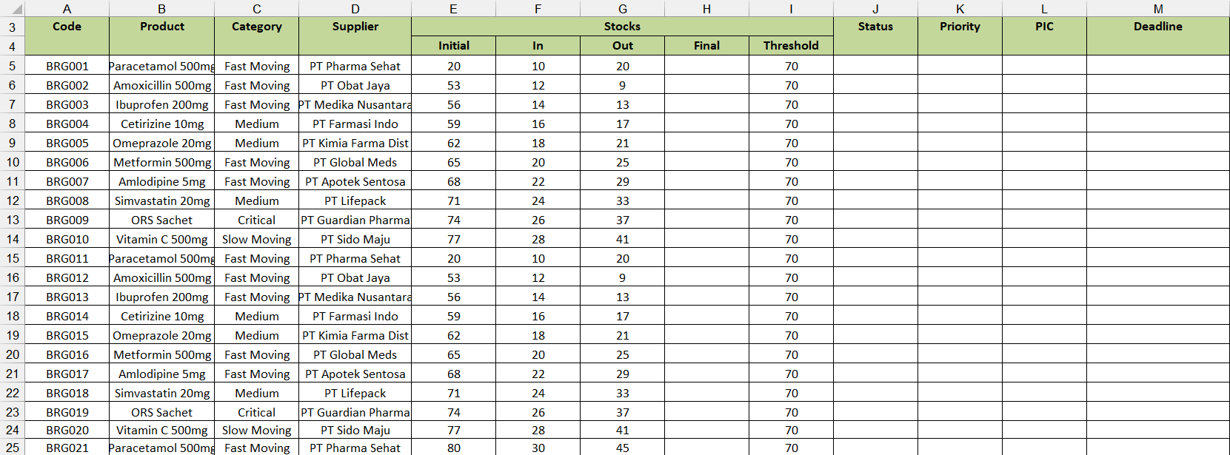
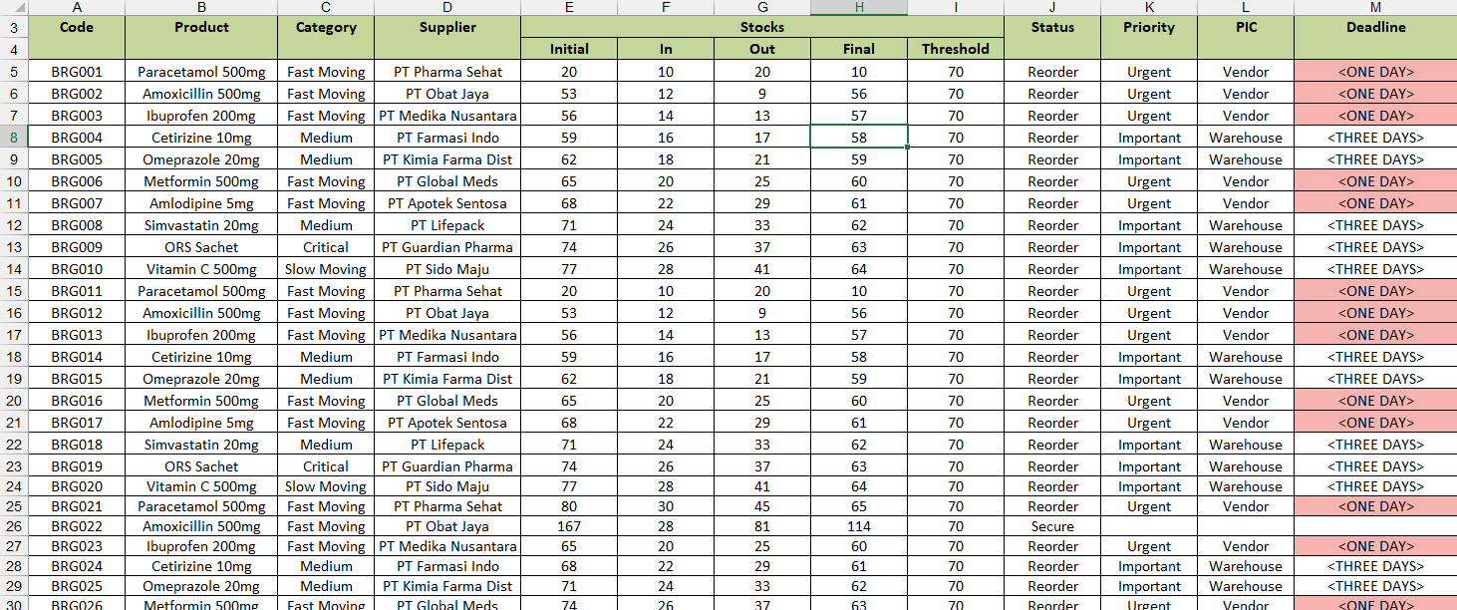
INVENTORY STATUS AUTOMATION
This data was lack of final stocks, inventory status, and define who will be facing the problem with the deadline, in this case we well complete the lack of data with:
Count final stock each product
Define status imventory, priority, deadline, and the PIC who will take a action. Using IF formula
Before
https://bit.ly/4qBwJef
After

Slide 9
INVENTORY STATUS AUTOMATION
With this structured data of inventory status, slightly we
Look that:
There are 4 category for each products, Fast moving, Medium, Slow Moving, and Critical
Over 83% Products must be reorder due to stockout
81 items were in urgent priority to reorder, and the most prioritized product is Paracetamol, Amoxcilin, Ibuprofen, and Amlodipine.
Most current stock is Vitamin C, and the less stock is Cetirizine

Slide 10
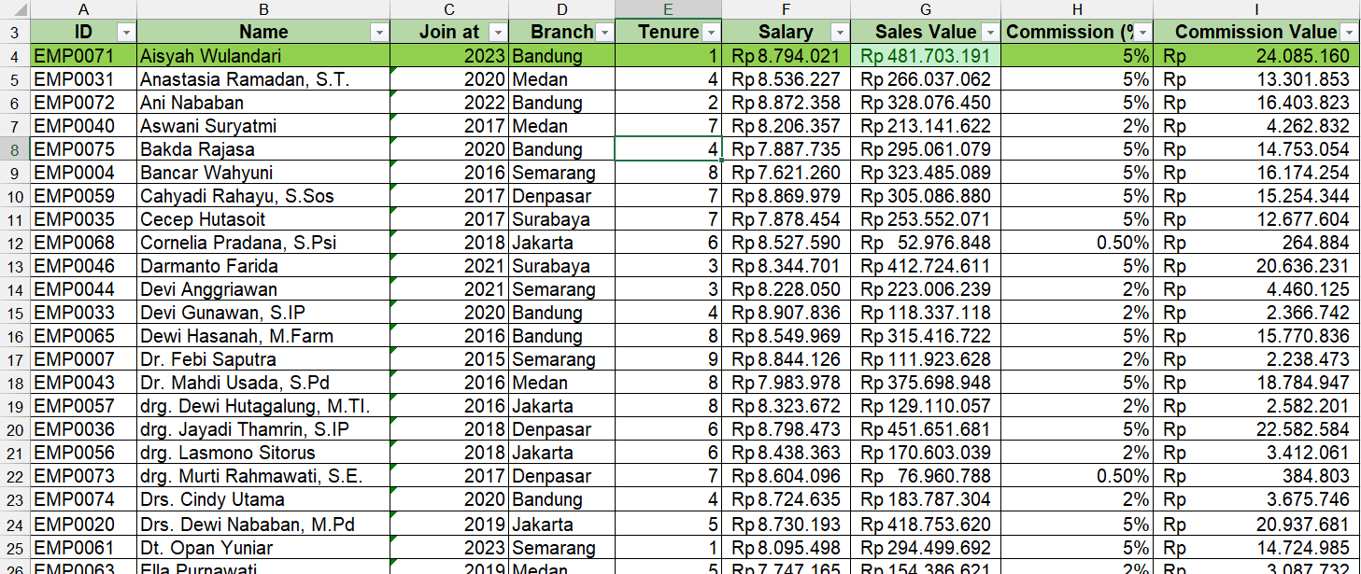
DATA INTEGRATION & ANALYSIS
Step by step Rules
Identify Employees by ID, Join date, Tenue, and salary
Matching annual sales value per person with VLOOKUP function
Clasify %commission each employees based on sales value
Analyze the correlation between data
Highlight Insight:
1. Total Employee by 2024 is 75 employees
2. There are 5 employees that achieve highest sales based in Bandung, Denpasar and Medan Branch
3. Bandung Branch get the highest Sales Achievement in 2024
https://bit.ly/4qBwJef

Slide 11
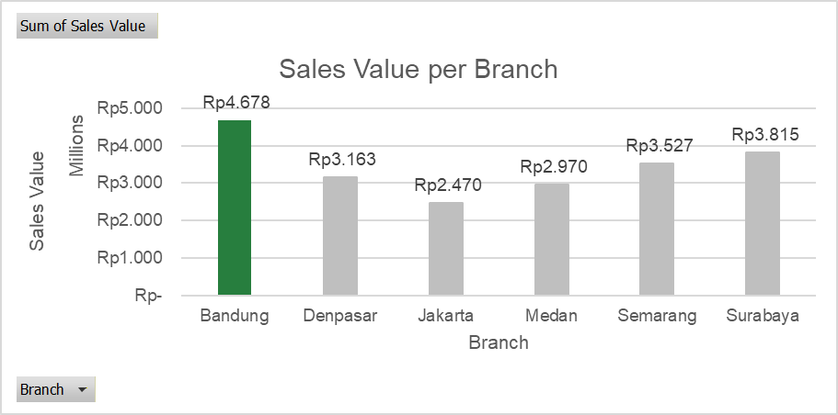
Bandung Branch has the highest Sales Achievement in 2024
Bandung reach Rp 4.6 Million Annual Sales, compare to other branches
This achievement means all the employees in Bandung Branch has a great sales performance, and bring the most productive employees
Explain your analysis in here

Slide 12
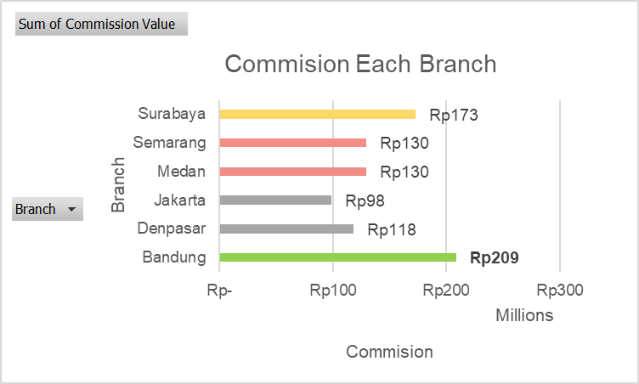
Rewards for The Employees
Explain your analysis in here
After a hardwork, great achievement, and calculation commission each employee per branch. We see from the graphic the total of commission.
Bandung branch was the most commission due to great sales achievement impact

Slide 13
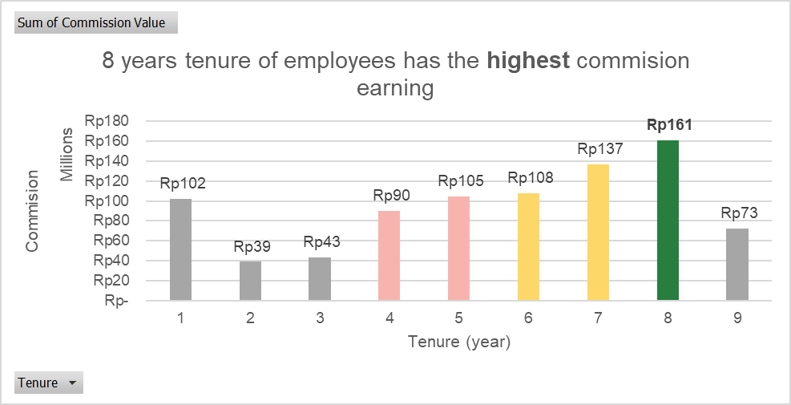
Correlation Between
Tenure and Commision Achieved
We can see from the graphic, the total of
Commision based on working period
The correlation between Tenure and
Commision is almost directly proportional
With the variances each tenures.
Employees with 8 years of work experiences
Was the highest commission earning in 2024.
where the length of work experience is
directly proportional to the level of
experience and the targets to be achieved,
so that employees have better
work performance.
Explain your analysis in here

Slide 14
Profile
Thank you
Contact Details
Phone :
+62 813 6664 9563
Email :
adinn41@gmail.com
Linkedin :
Adin Nugroho

